Slide 1
BRING YOUR
GAME TO WORK
Train-the-Trainer Workshop
August, 2016

Slide 2
What are employers looking for?
Attitude
Education
Specific Skills
Job Experience
Work Ethic
Work History
Express Employment Survey, August 2015

Slide 3
SIGNS OF DECLINE

Slide 4
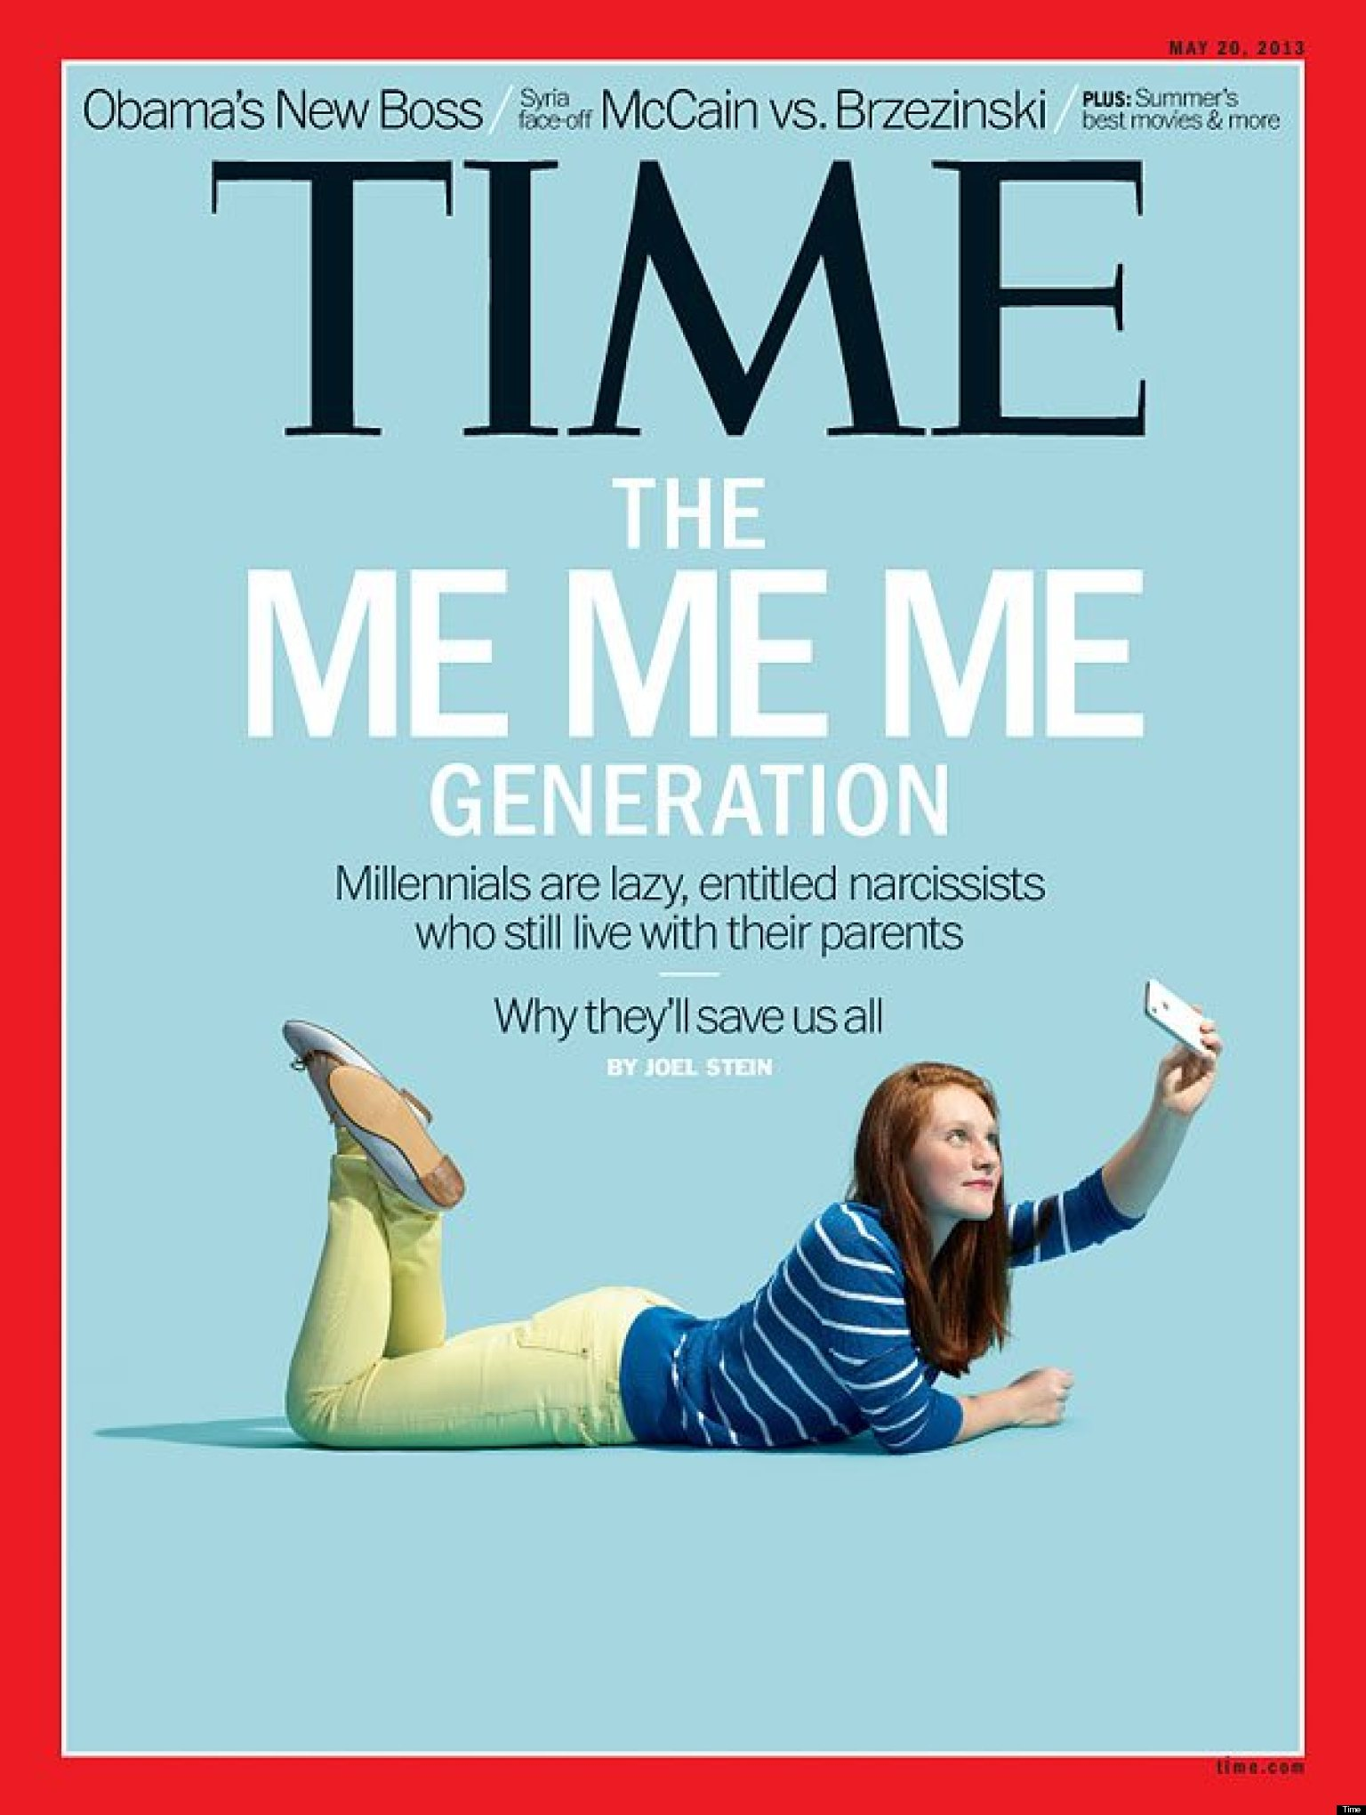
SIGNS OF DECLINE?
“Lazy, entitled narcissists”

Slide 5
SIGNS OF DECLINE?
“Privileged, narcissistic, entitled, spoiled and promiscuous.”
- Life Magazine, 1968
“There they are, those preening narcissists who have to
document every banal moment with their cutting-edge
communications technology.”
- Newsweek, 1985

Slide 6
SIGNS OF DECLINE?
“Our youth now love luxury. They have bad manners, contempt for authority; they show disrespect for their elders and love chatter in place of exercise; they no longer rise when elders enter the room; they contradict their parents, chatter before company; gobble up their food and tyrannize their teachers.”
-Socrates

Slide 7
SIGNS OF DECLINE

Slide 8
SIGNS OF HOPE

Slide 9
Today’s AGENDA
Introduction and Overview
The Work Ethic Gap
The A Game Methodology and Delivery
Experience the Curriculum
Skills Practice

Slide 10
The Center For Work Ethic Development
Founded in 2009
The nation’s only institution focused on the research and advancement of Work Ethic
Used by more than 600 locations around the world
Providers of the Certificate of Work Ethic Proficiency

Slide 11
Four questions
What is your name?
What is your current job?
What was your first job with a paycheck?
What was a key lesson you learned at that job?

Slide 12
THE WORK ETHIC GAP

Slide 13
The work ethic gap
Three quarters of employers said the incoming workforce is unprepared for the job market and lack an adequate Work Ethic
Bentley University – January, 2014

Slide 14
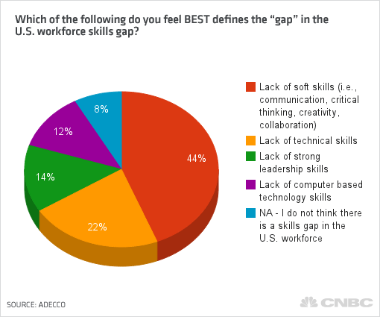
The work ethic gap
ADECCO – September, 2014

Slide 15
The work ethic gap
Only 9 percent of four-year college students think that being prepared for work includes “Work Ethic”
National Association of Colleges and Employers – October, 2013

Slide 16
Development of work ethic
Family
School
Workplace
Mass Media

Slide 17
WHY IS THERE A WORK ETHIC GAP?
The average parent spends 15 minutes a WEEK in meaningful dialogue with their children
Family

Slide 18
WHY IS THERE A WORK ETHIC GAP?
Braun Research, 2014
“Doing chores was instrumental in predicting success in both relationships and their career.” – University of Minnesota, September 2015

Slide 19
WHY IS THERE A WORK ETHIC GAP?
School

Slide 20
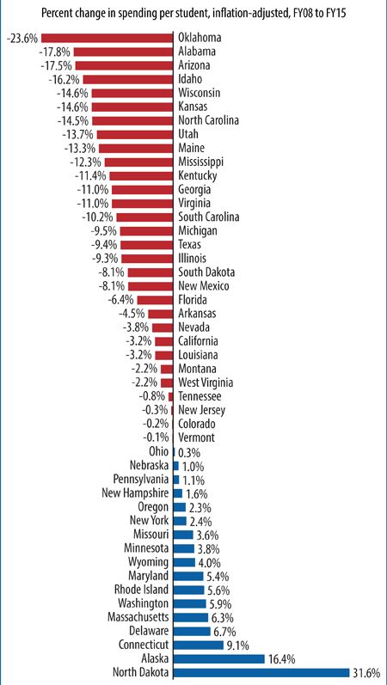
WHY IS THERE A WORK ETHIC GAP?

Slide 21
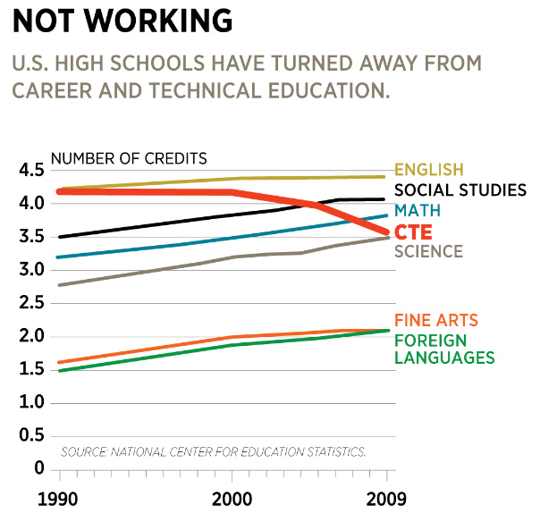
WHY IS THERE A WORK ETHIC GAP?

Slide 22
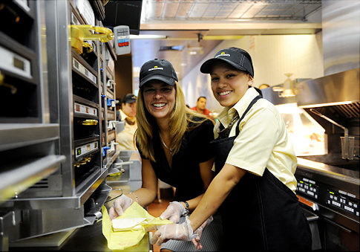
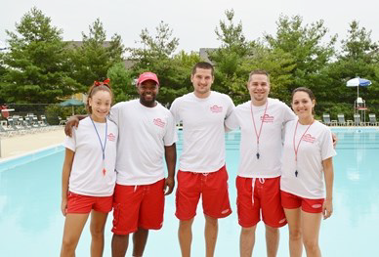
WHY IS THERE A WORK ETHIC GAP?
Workplace

Slide 23
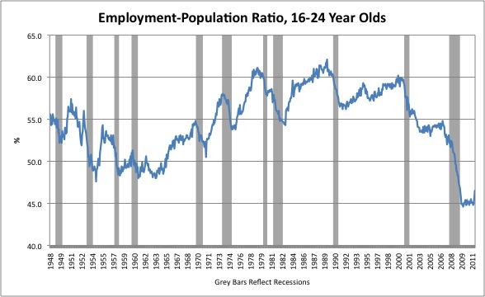
WHY IS THERE A WORK ETHIC GAP?

Slide 24
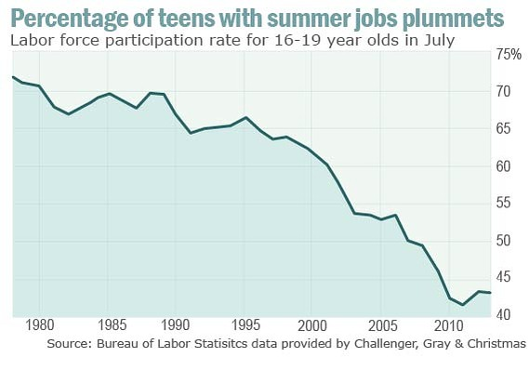
WHY IS THERE A WORK ETHIC GAP?

Slide 25
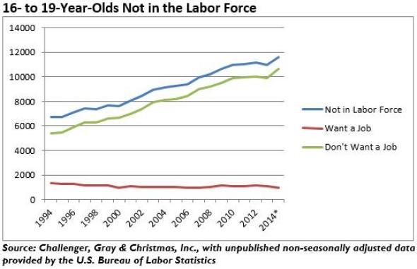
WHY IS THERE A WORK ETHIC GAP?

Slide 26
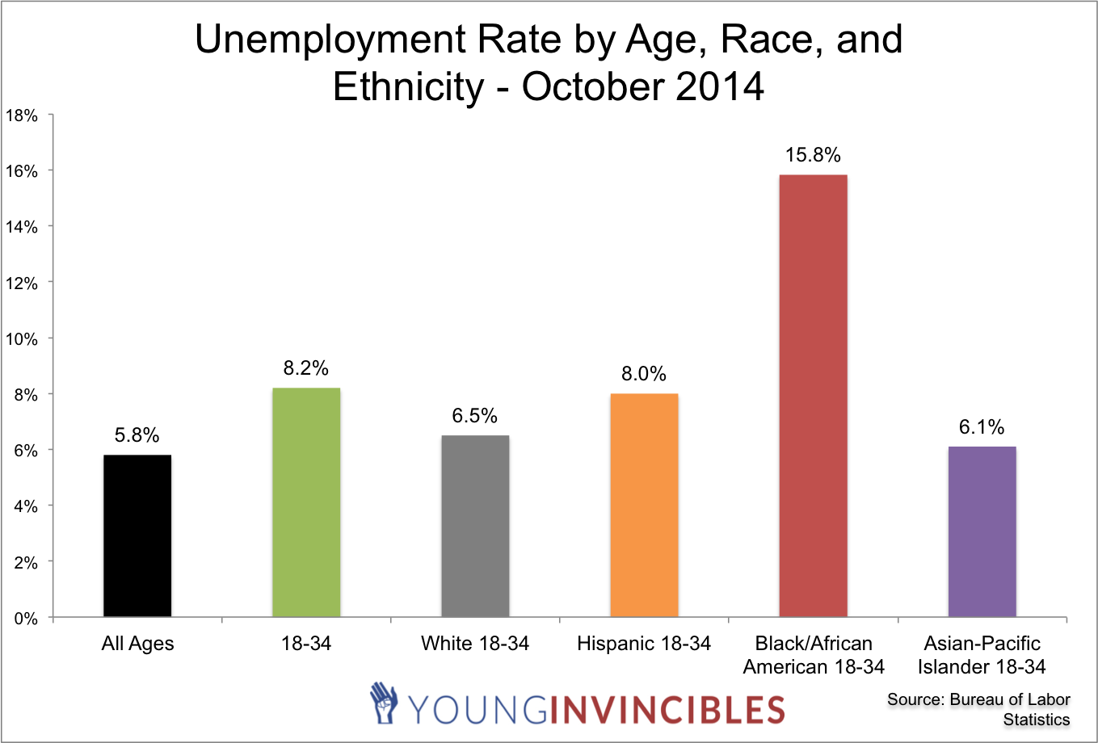
WHY IS THERE A WORK ETHIC GAP?

Slide 27
WHY IS THERE A WORK ETHIC GAP?
Mass Media

Slide 28
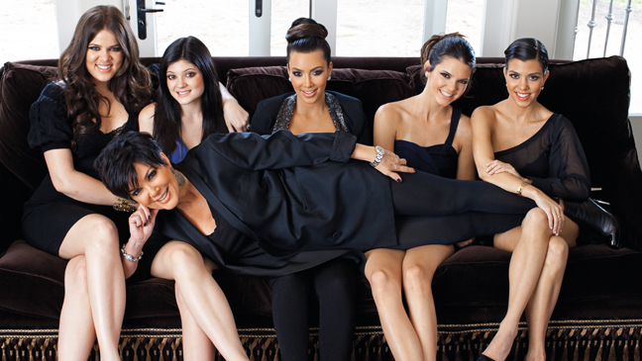
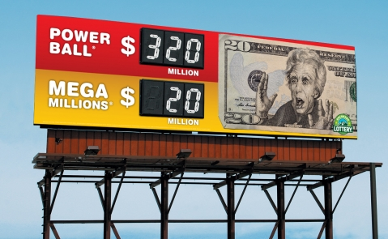
WHY IS THERE A WORK ETHIC GAP?

Slide 29
THE IMPACT OF THE WORK ETHIC GAP

Slide 30
Interview ineffectiveness
“How important is being able to demonstrate soft skills, such as work ethic, in the job interview process?”
Wakefield Research, July 2013

Slide 31
Job selection and performance
88 percent of managers said new hires needed a strong work ethic to succeed
Only 15 percent said their new hires possessed that trait
“Most companies are hiring talent based on soft skills like attitude and hard work, with the hope that they can train them to be up to par on things like tech skills and industry knowledge.”
Instructure Employer Survey, March 19, 2015

Slide 32
TERMINATION
1. Dishonesty or lack of integrity on the job
2. Lying on a resume
3. Refusing to follow directions
4. Conducting personal business at work
5. Inconsistency – unreliable work and behaviors
6. Inability to get along with others
7. Inability to actually do assigned job tasks
8. Performing tasks slowly, with multiple errors
9. High absenteeism rate
10. Drug and/or alcohol abuse

Slide 33
IMPACT ACROSS INDUSTRY AND EXPERIENCE
Forbes Magazine, January, 2012

Slide 34
WORK ETHIC RESEARCH AND INSIGHTS

Slide 35
Can you develop WORK ETHIC?
YES!

Slide 36
1,500 EMPLOYERS

Slide 37
WHAT IS WORK ETHIC?
Work ethic is a set of seven behavioral competencies that are the foundation of workplace success.

Slide 38
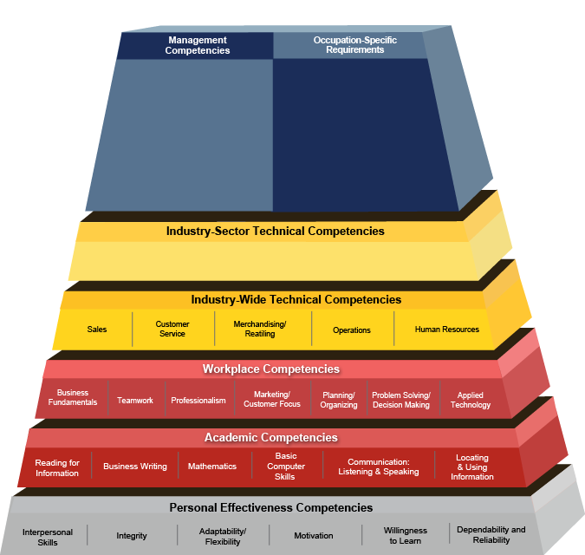
USDOL Competency model
Technical
Academic
Foundational

Slide 39
The LINK TO EMPLOYMENT SUCCESS
These Work Ethic skills are more critical to job success than a degree
Dr. James Heckman, Nobel Laureate

Slide 40
categories of workplace competency
Technical
Technical
Foundational
Foundational
Academic
Academic

Slide 41
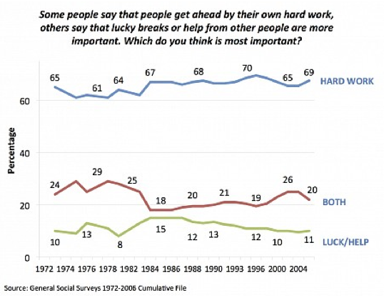
Today’s reality

Slide 42
THE SOLUTION

Slide 43
BRING YOUR
GAME
TO WORK

Slide 44
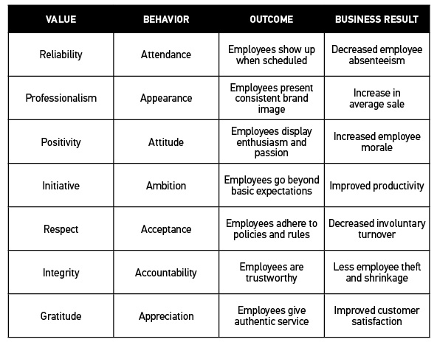
The components of WORK ETHIC

Slide 45
Behavior definitions
TTENDANCE
PPEARANCE
is showing you’re reliable in every phase of your life. Be on time, every time.
is being professional both in the way you act, and the way you look. Choose to be a pro.
is staying positive in every situation. Take control of the way you react.
is taking initiative and adding value. Do more than the minimum.
TTITUDE
MBITION

Slide 46
Behavior definitions
CCEPTANCE
is having respect and following direction. Be coachable and play by the rules.
is living honestly and having integrity with every decision you make. Refuse to rationalize bad decisions.
is demonstrating your gratitude towards others. Provide selfless service.
CCOUNTABILITY
PPRECIATION

Slide 47
The components of WORK ETHIC

Slide 48
The development challenge

Slide 49
The development challenge
Conscious Incompetence
Conscious Competence
Unconscious Competence
Unconscious Incompetence

Slide 50
FUNDAMENTALS OF THE CURRICULUM

Slide 51
BRING YOUR
GAME
TO WORK

Slide 52
Keys to training work ethic – Page 6
Experiential Learning
Peer to Peer Model
Applicability and Flexibility

Slide 53
Experiential learning
David Kolb first created his model for experiential learning by utilizing 4 key concepts. These concepts were expressed in the experiential learning circle that involves
concrete experience - observation and experience - forming abstract concepts - testing in new situations

Slide 54
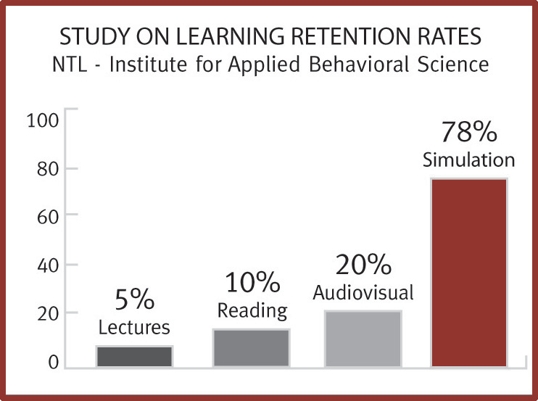
Experiential learning

Slide 55
Peer-to-peer MODEL
Peers teach each other by providing real world examples and providing a credible “second voice”
Peers support this shared content and encourage their peers to adopt this new shared norm

Slide 56
Peer-to-peer MODEL

Slide 57
flexibility and Applicability
Utilizing a flexible teaching allows trainers to engage a specific audience in the learning activity
This ensures applicability for participants which is critical in removing early barriers to learning and adoption

Slide 58
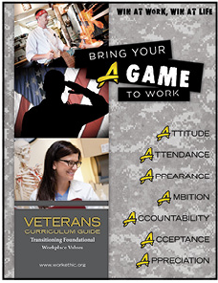
Program variations

Slide 59
Components of bring your a game
Curriculum Guide: Instructor Cornerstone
Participant Workbook: Consumable
Participant Textbook: Reusable
Multimedia Resources: Supplemental A/V
Online Certification: Proves Mastery

Slide 60
IMPACT

Slide 61
SUCCESS STORIES
Arapahoe/Douglas Works!
Twice the level of employer satisfaction
Ferris State University
40% increase in job sustainability
Papa Murphy’s
100% increase in job performance

Slide 62
Business impact

Slide 63
CURRICULUM OVERVIEW

Slide 64
Modules
Introduction
Attitude
Attendance
Appearance
Ambition
Accountability
Acceptance
Appreciation
Capstone

Slide 65
OUR learning MODEL – Page 7
Clarify
Commit
Carry Out
Continue
WHAT.
DO!
HOW:
WHY?

Slide 66
Long-term behavioral change
Conscious Incompetence
Conscious Competence
Unconscious Competence
Unconscious Incompetence
WHAT.
HOW:
WHY?
DO!

Slide 67
USING AN ACTIVITY PAGE – page 9
Name of Activity:
Duration:
Supplies Needed:
Tags:
Workbook: Textbook:

Slide 68
Activity TAGS – Page 10 (adult)
Everyone Can Do This
Low Energy Class
High Energy Class
Alternative Learning Styles
Small Class
Large Class
Job Seekers
Extensive Employment Experience
Limited Employment Experience
Personality Shapes

Slide 69
USING AN ACTIVITY PAGE – Page 9
Name of Activity:
Duration:
Supplies Needed:
Tags:
Workbook: Textbook:

Slide 70
USING AN ACTIVITY PAGE
PREP: Pre-class work
SAY: Basic script
DO: Activity instructions
RECAP: Closing the learning loop

Slide 71
USING JOURNAL PAGES – page 11
Reflection: Part of the activity recap section
Critical component for introverted learners

Slide 72
SAMPLE TRAINING OUTLINES – pages 15-18
Four-Hour Mini-Session
Eight-Hour Workshop
16-Session Class

Slide 73
TRAINING
BRING YOUR
GAME TO WORK

Slide 74
CHAPTER Contents
Learning Objectives
Clarify/Define
Commit/Discuss
Activities
Taking Action

Slide 75
OUR TRAINING MODEL
Clarify
Commit
Carry Out
Continue
WHAT.
DO!
HOW:
WHY?

Slide 76
Key training techniques
Be the Guide From The Side
Use the Socratic Method
Create a Positive Learning Loop
Focus on both “What” and “Why?”
Build shared accountability

Slide 77
SAMPLE
TRAINING EXERCISES

Slide 78
Clarify/Define
CCOUNTABILITY

Slide 79
CLARIFY/DEFINE
Living honestly and having integrity with every decision you make.
Refuse to rationalize bad decisions.

Slide 80
COMMIT/DISCUSS
Has anyone ever questioned your honesty?

Slide 81
COMMIT/DISCUSS
Is it ever okay to do something you know is wrong?

Slide 82
COMMIT/DISCUSS
What are the different degrees of honesty?

Slide 83
Employer expectations
Follow the rules at work, even when no one is looking
Build a reputation for trust and accountability
Maintain honesty and integrity, even when they make a mistake
Have standards for their own actions and follow company rules
Build good habits by being honest, no matter the cost

Slide 84
What shape is your personality?
Squares are organized and hard workers. Squares like structure and rules and dislike situations in which they don’t know what is expected of them. “Tell me the deadlines and I’ll get the job done,” Squares say - And they deliver. They prefer working alone to team work. Logical, they think sequentially…a, b, c, d. They collect loads of data and file it so information is easy to locate; but have trouble saying, “I’ve got enough information.” Squares are slow to make decisions and are resistant to change. They will always ask ‘why’ when asked to do a task differently.

Slide 85
What shape is your personality?
Triangles are natural leaders. Triangles are decisive and able to focus on the goal. Triangles have confidence in themselves and in their opinions. Triangles will not hesitate to tell everyone else the way the world is. Triangles can be dogmatic and shoot from the hip. They like recognition and are delighted to tell people about their accomplishments. Triangles can be self-centered and egotistical. They put stock in status symbols. American business has been run by triangles. Triangles make decisions quickly and are energized by change when it moves toward a goal.

Slide 86
What shape is your personality?
Pentagons are seekers and explorers and searching for ways in which they can grow and change. Pentagons ask ‘who am I?’ and ‘what is the world about?’ They are the most receptive of the five shapes to new learning. Pentagons are the only shape that’s not frozen, and they can cause their co-workers confusion when they change from day to day. All people go through pentagon periods when they’re in a state of change. Pentagons have difficulty making decisions as they can see all sides. They thrive on change as they want to experience new ways of doing things.

Slide 87
What shape is your personality?
Circles are people people. Circles have the most empathy, perception and consideration for the feelings of others. Circles listen and communicate well. They read people and can spot a phony right off. Circles like harmony and have the greatest difficulties in dealing with conflict and making unpopular decisions. They are easily swayed by other people’s feelings and opinions. Circles can be an effective manager in an egalitarian work place, but have difficulty in political environments with a strong hierarchy. Circles prefer that other people make decisions and they would be happy if nothing ever changed and the workplace was one big happy family.

Slide 88
What shape is your personality?
Lightning bolts are creative, ‘what if?’ people who are always thinking of new ways to do something. Their minds never stop and they do cognitive leaps from A straight to D. Lightning bolts see the forest and miss the trees. They don’t like highly structured environments. Lightning bolts don’t tolerate the mundane and have a short attention span. Lightning bolts must get excitement at work. They are highly motivated by change and see it as fun. They are quick to make decisions, but rarely consider the impact of their choices.

Slide 89
What shape is your personality?
Circle the shape you like the most.
Star the shape you like second.
Check mark your least favorite.
This is your strongest personality style, and drives your behavior.
This shape represents your fall back personality style, and is where you go when stressed.
This is the shape that you will likely have the most conflict dealing with.

Slide 90
Josh Davies
Chief Executive Officer
The Center for Work Ethic Development
jdavies@workethic.org
303.433.3243

